Slide 1
Project Based Learning –VI
Submitted by: Vanshita (2110993882)
Faculty Coordinator: Dr. Shruti Arora
:
Chitkara University Institute of Engineering and Technology,
Chitkara University, Punjab

Slide 2
Table of Contents
Introduction
Problem Statement
Technical Details
Key Features
Project Highlights
Conclusion

Slide 3
Introduction
The aim of this project is to create a digital English proficiency assessment tool that overcomes the shortcomings of current assessment techniques. This application will give users an easy-to-use platform to evaluate their language proficiency in a variety of areas, such as grammar, vocabulary, speaking proficiency, and listening comprehension. Challenge: For many users, the inability to write or speak English fluently limits their ability to get knowledge from a variety of chances. Solution: The digital assessment tool for English proficiency seeks to enable people all over the world to improve their language abilities and confidently pursue their academic and professional goals by tackling the following issues.

Slide 4
Problem Statement
English language competency is essential for people looking for chances for personal, professional, and educational advancement in today's globalised society. However, scalability, consistency, and real-time feedback are frequently lacking in traditional techniques of evaluating English language proficiency. An all-encompassing, cutting-edge technical solution is desperately needed to quickly and conveniently assess English skill levels.

Slide 5
Technical Details
Model Creation:
Matplotlib
MySQL
Pandas
scikit-learn
NumPy
Scipy
Surprise
Front-End: the front end is created using The following technologies.
HTML
CSS
JavaScript

Slide 6
Key Features
1. Adaptive Testing: Tailored assessment that adjusts difficulty based on user responses.
2. Predictive Modeling: Utilizing machine learning to predict proficiency levels from user data.
3. Dynamic Question Selection: Choosing test items based on user performance to maximize information gain.
4. User-Friendly Interface: Intuitive design for seamless navigation and engagement.
5. Scalability: Ability to handle large volumes of users and diverse linguistic contexts.
6. Fairness and Equity: Mitigating biases and ensuring inclusivity in assessment process.

Slide 7
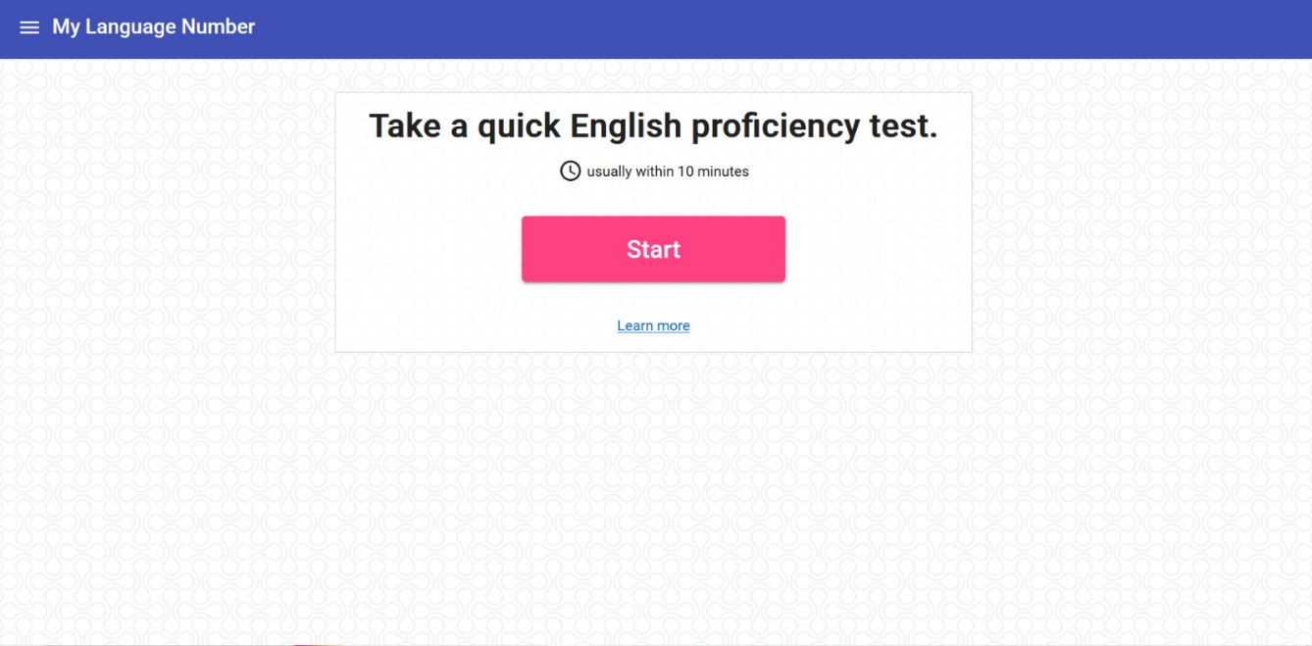
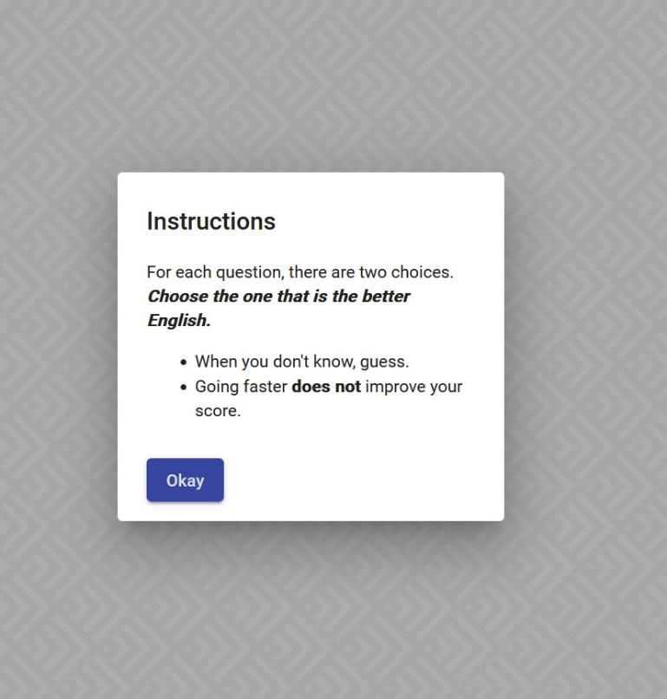
Project Highlights

Slide 8
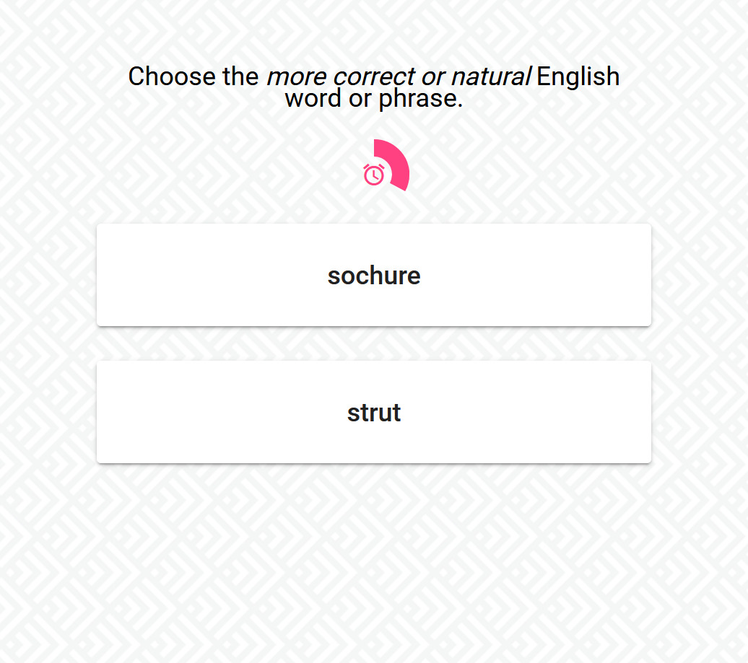
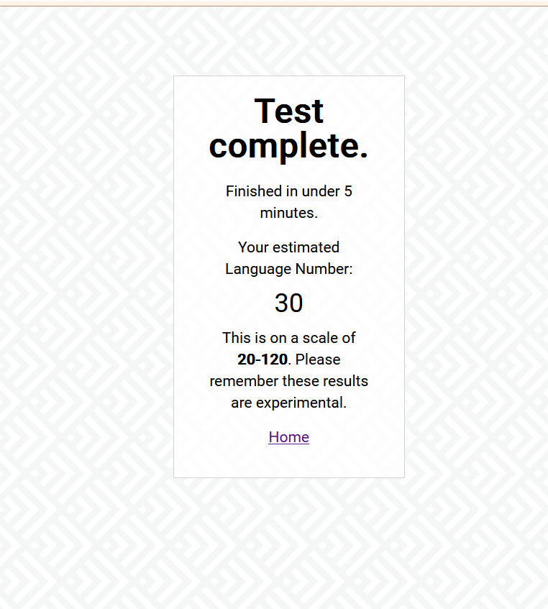

Slide 9
Conclusion
During the English Proficiency Test initiative, we set out to transform language evaluation. We created an adaptive exam that uses dynamic question selection and predictive modelling to offer indivisualised evaluations of English language proficiency. Our key conclusions center on the value of user-centric design, the effectiveness of predictive analytics in evaluation, and the way technology may improve inclusivity and fairness in language testing. We are dedicated to keeping up our efforts to develop and enhance language assessment techniques going forward for the benefit of students everywhere.

Slide 10


